Slide 1
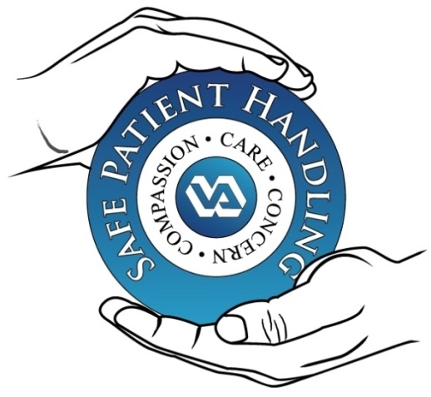
The Safe Patient Handling and Mobility Program:
How it relates to you and your job
Daniel Agbogidi, BSN, RN
Safe Patient Handling & Mobility
Program Manager

Slide 2

National Directive 1611 establishes Safe Patient Handling and Mobility as a Veterans Administration Priority.
1
Medical Center Policy 118-21-013 establishes the Safe Patient Handling and Mobility policy for the VACCHS.
2
Safe Patient Handling and Mobility is of nationwide importance.
Notes:
PLAY ANA video!

Slide 3
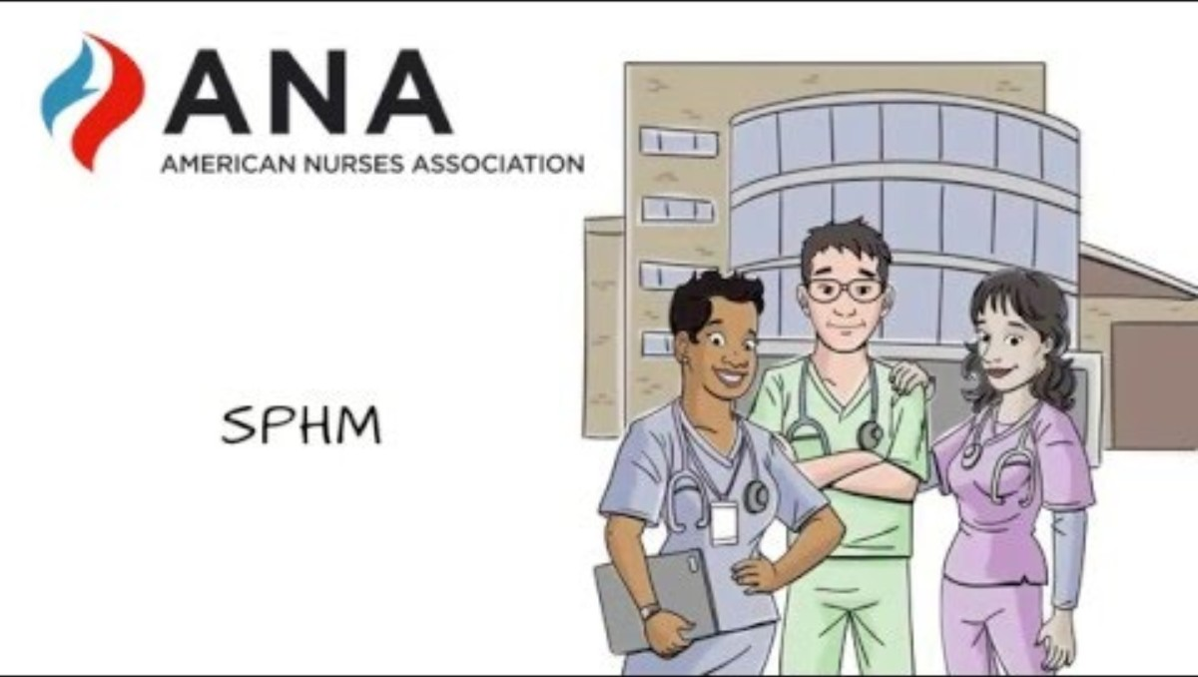
ANA Presents Safe Patient Handling and Mobility
https://youtu.be/Bss2VEvrdcw?si=Qpu0fF4hVdrUp18e

Slide 4
VHA Directive
1. POLICY
It is Veterans Health Administration (VHA) policy that a Safe Patient Handling and Mobility (SPHM) program be implemented in every Department of Veterans Affairs (VA) medical facility and that SPHM technology be incorporated as appropriate in the planning, design and construction of new construction and renovation projects, to protect VHA health care workers and Veterans from injuries due to patient handling and mobility, ensure that all Veterans have equitable opportunity to access SPHM technology, as needed, and to meet and improve Veteran care needs. Employees must utilize SPHM technology for routine and urgent patient handling tasks that require lifting over 35 pounds of patient weight or when performing tasks that require the generation of excessive force, such as repositioning a Veteran in a bed by pushing, pulling or supporting a Veteran during mobility. In addition, all design projects in spaces used by Veterans must include VA medical facility SPHM Program Manager (PM) input.

Slide 5
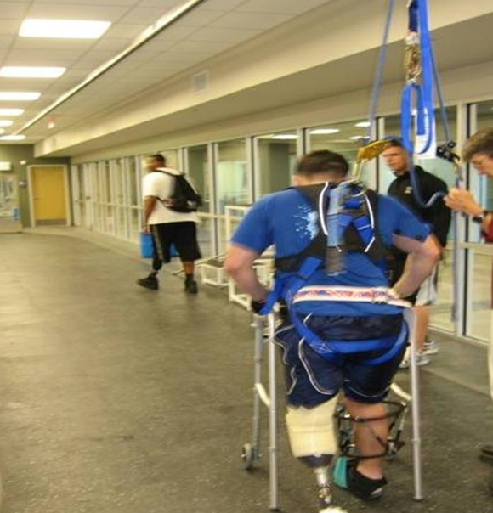
Why is there a need for a SPHM program?
SPHM is changing the environment of care to make it possible to move patients safely and with dignity while improving patient outcomes.
Notes:
Musculoskeletal Injuries in Caregivers
Primary driver of loss of nurses from workforce
Increasing rates in health care; up 6% in 2011 to 283 cases with days away from work/10,000 FTE
2012 BLS data – Nurses 5th and NAs 2nd of all industry workers (injuries with lost time days)
Effect on burnout, turnover, preventable disability, and early retirement

Slide 6
Why is there a need for a SPHM program?
Musculoskeletal Injuries in Caregivers
Primary driver of loss of nurses from workforce
2012 BLS data – Nurses 5th and NAs 2nd of all industry workers (injuries with lost time days)
Without lift equipment, nurses lift 1.8 tons in 8 hrs
35 lb. patient lifting limit under best of circumstances (cooperative, well-placed patients, no tubes, catheters, etc.)
Increasing injury rates in health care, but not in VA… VA rates are steadily declining
Notes:
Musculoskeletal Injuries in Caregivers
Primary driver of loss of nurses from workforce
Increasing rates in health care; up 6% in 2011 to 283 cases with days away from work/10,000 FTE
2012 BLS data – Nurses 5th and NAs 2nd of all industry workers (injuries with lost time days)
Effect on burnout, turnover, preventable disability, and early retirement

Slide 7
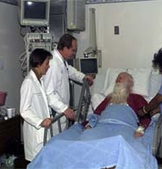
Why are Patient Care Providers at
High Risk?
Patients have changed…
  Patients are sicker
  Patients are more physically dependent on staff
  Patients are larger
  So…. there is more
  risk of injury to staff.

Slide 8
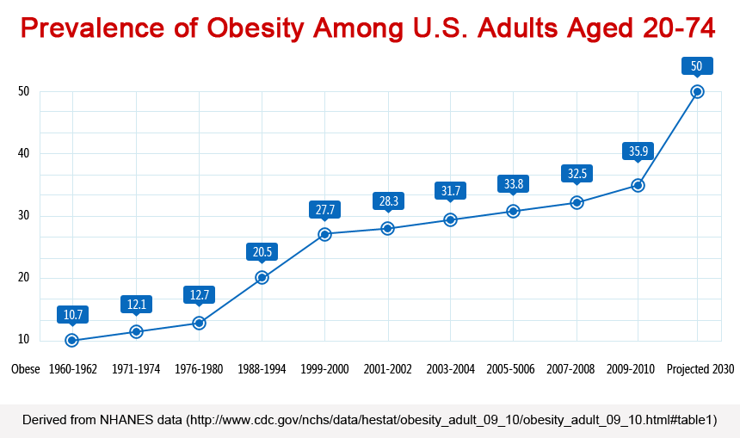
Half of Americans will be obese by 2030, if things continue the way they are now.

Slide 9
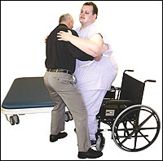
Bariatric Patient Handling Statistics
Patients with a BMI > 35 comprise only 10 % of patient population
Handling patients with a BMI > 35 was associated with
  29.8 % of injuries
  27.9 % of lost time
  37.2 % of restricted time
(Randall SB, Pories WJ, Pearson A, Drake DJ. Expanded occupational safety and health administration 300 log as metric for bariatric patient-handling staff injuries. Surg Obes Relat Dis. 2009;5(4):463–468.)

Slide 10
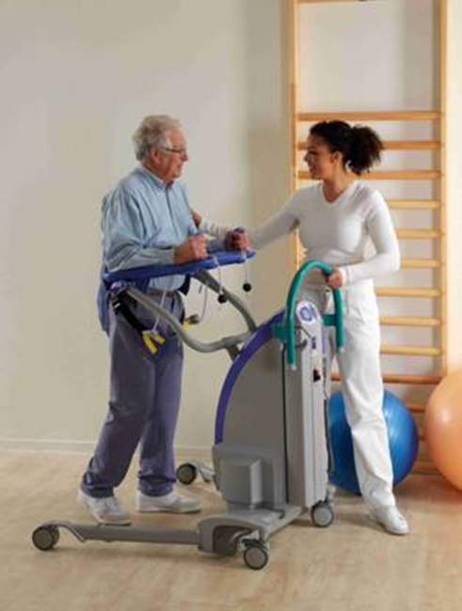
Why is there a need for a SPHM program?
Decrease the risk of musculoskeletal injuries for ALL healthcare workers
Facilitate patient mobilization and resultant benefits
Improve the quality of care and the quality of life of our veteran patients/residents

Slide 11
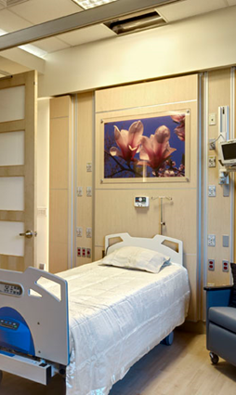
What is the VA SPHM Program?
National SPHM Directive
VHA Directive 2010-032 - Safe Patient Handling Program and Facility Design
Requires a SPHM Program in each facility
Program includes common elements
Requires planning for SPHM in design & construction

Slide 12
What is the VA SPHM Program?
SPHM Program Elements:
SPHM Facility Policy
Leadership:
  Program Manager, at least 1 FTE
  Unit Peer Leader program (1 per shift per clinical area)
  VISN POC
Training (multiple services and levels)
Patient assessment process used to recommend equipment for individual needs of each patient
Oversight from a facility committee (ARB, EOC or other)
Equipment
  Overhead lift systems and other equipment as necessary
  Determined by unit-based ergonomic assessments

Slide 13
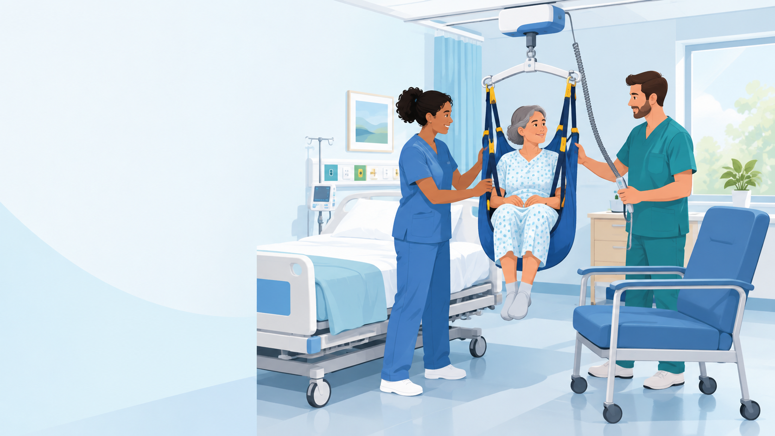
Safe Patient Handling: Use the Right Tools
Using SPHM equipment helps protect both staff and Veterans.
Use the appropriate SPHM equipment for patient-handling and mobility tasks.
Equipment is most effective when it is readily available, in working order, and staff are trained to use it.
If equipment cannot be used, communicate the barrier and seek assistance before proceeding whenever possible.
After an injury or near miss, report it promptly so the team can review what happened and improve safety.
Key message: Safe patient handling is a shared responsibility—plan the move, use the equipment, and ask for help.
Notes:
“SPHM is about preventing injuries through planning, teamwork, and the consistent use of available equipment. Reporting barriers and near misses helps us improve the system, not place blame.”

Slide 14
Patient Handling
Equipment & Aids

Slide 15
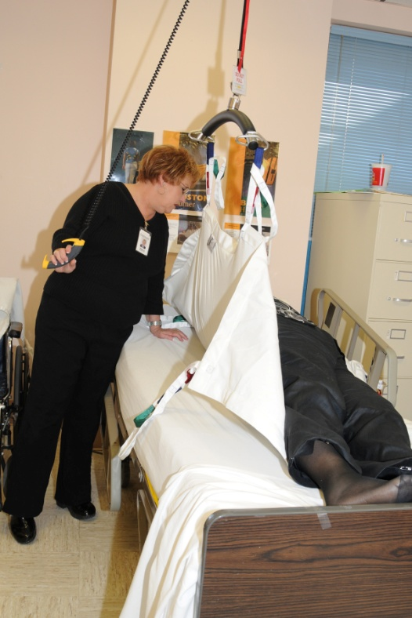
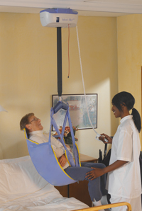
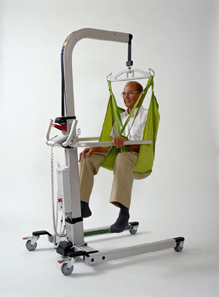
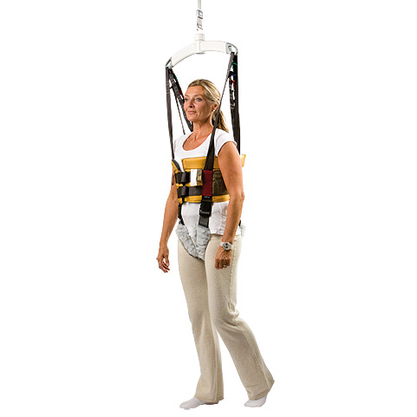
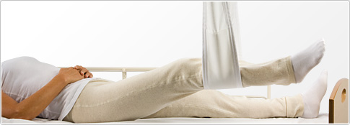

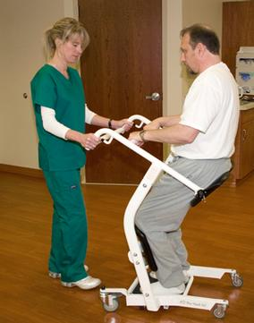
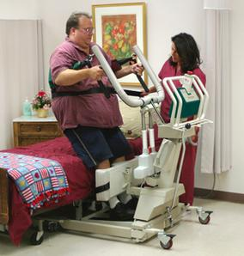
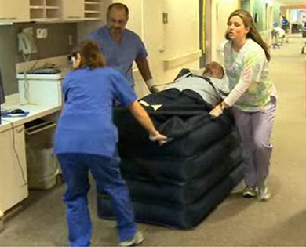
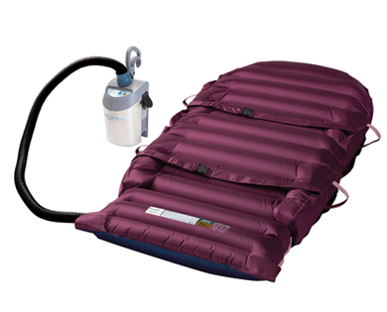
Notes:
From upper left, in a circle: Ceiling lift with Repositioning sling; Ceiling lift with seated sling; Floor lift with seated sling; walking sling; turning sling; Evacuation Hoverjack; Hovermatt; bariatric capacity sit to stand lift; non-powered stand aid; limb lifter.

Slide 16
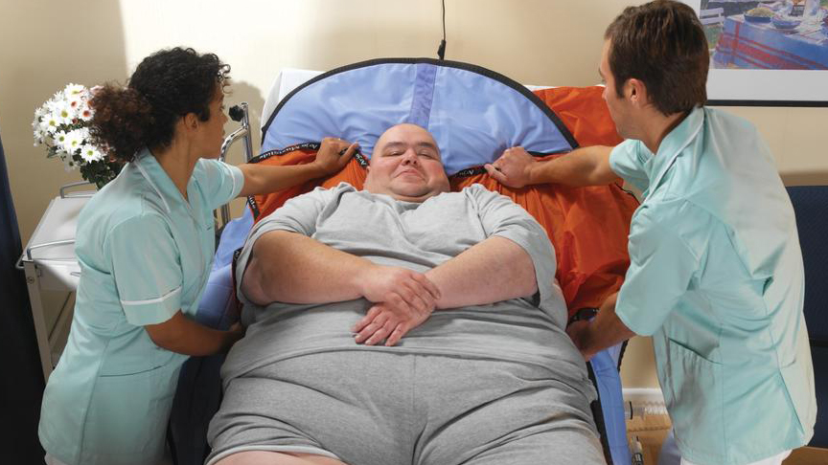
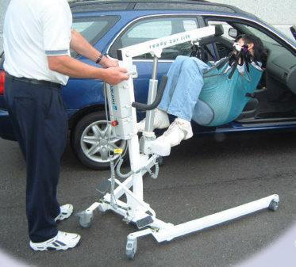
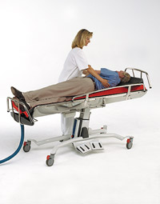
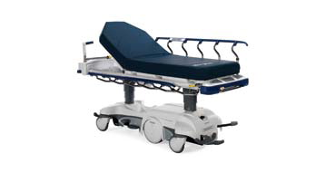
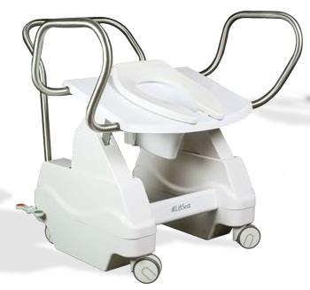
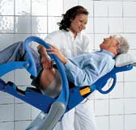
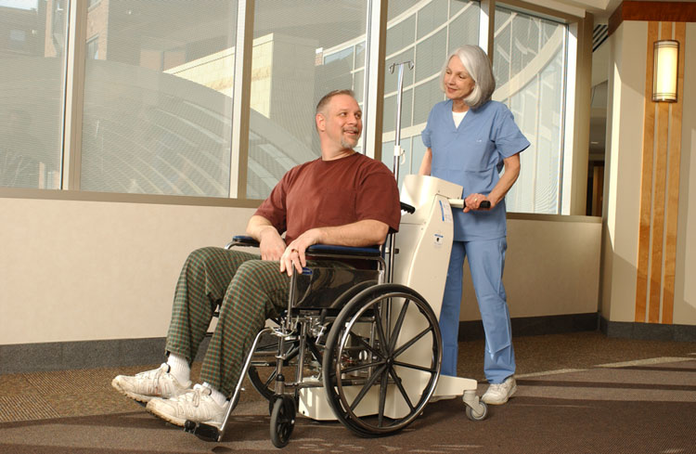
Notes:
From upper left, in a circle: Slide sheet used to install a sling; car lift; turning shower trolley; ergonomic, hip-elevating hygiene chair; powered, elevating toilet seat; motorized wheelchair mover; motorized stretcher.

Slide 17
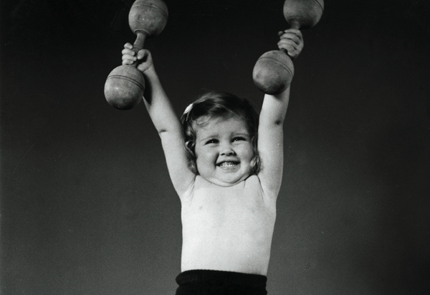
Health Care Workers are the ONLY Occupation that Believe 100 pounds is light!

Slide 18

Take the TIME
Use the Safe Patient Handling Equipment to
SAVE YOUR SPINE
REMEMBER: Do not lift more than 35 lbs. !

Slide 19

Notes:
Thanks

